Slide 1
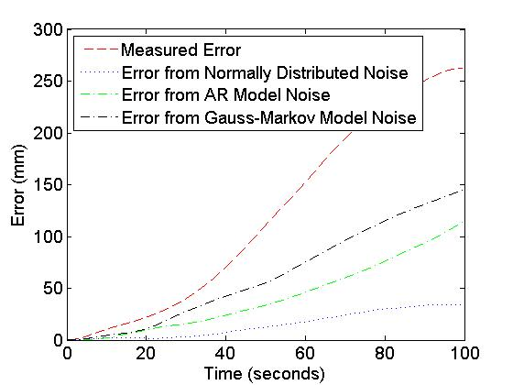
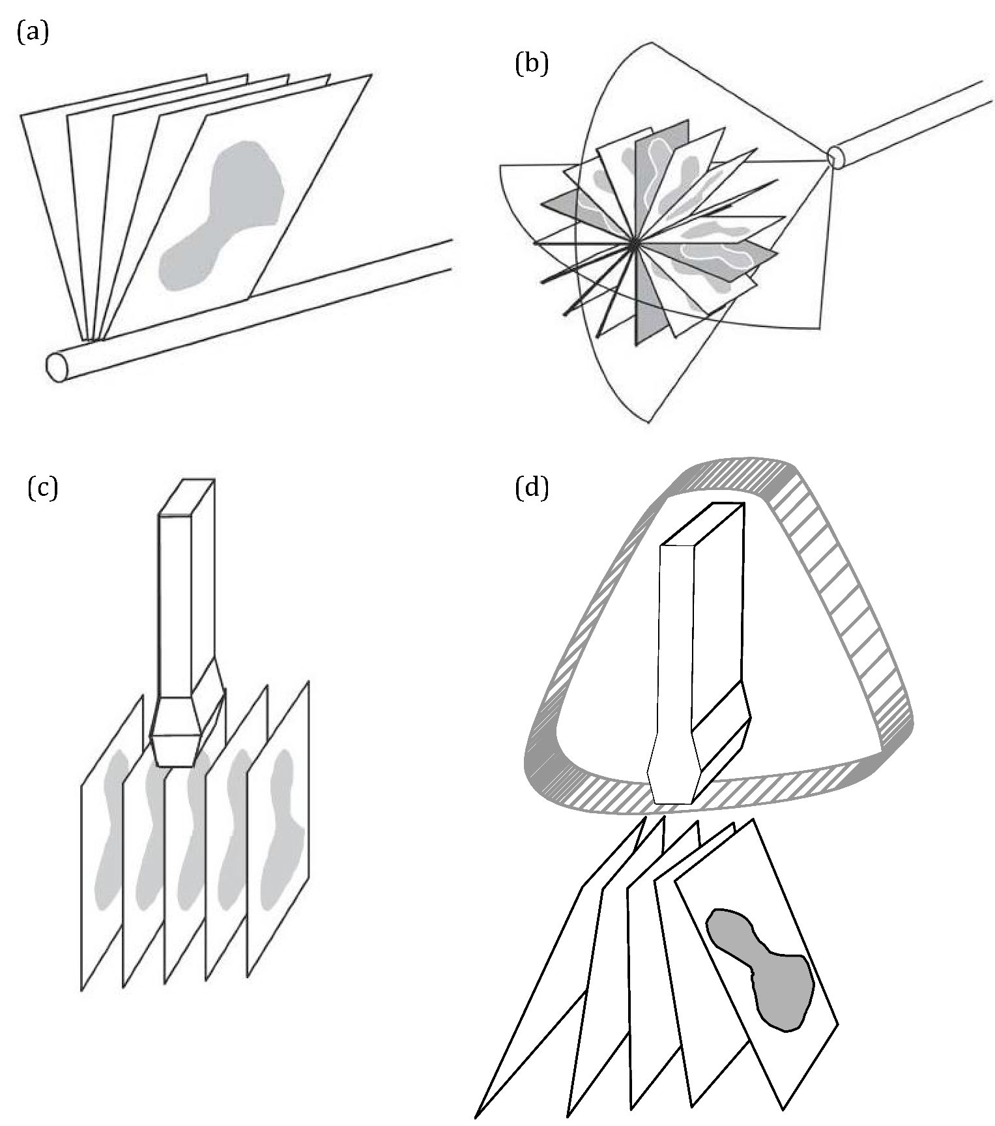
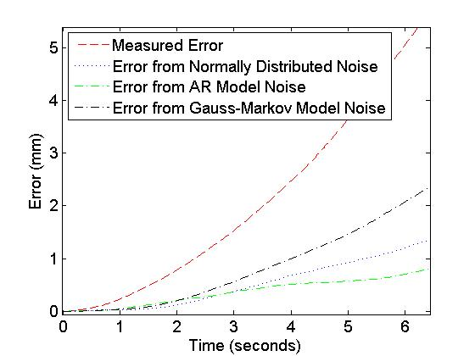
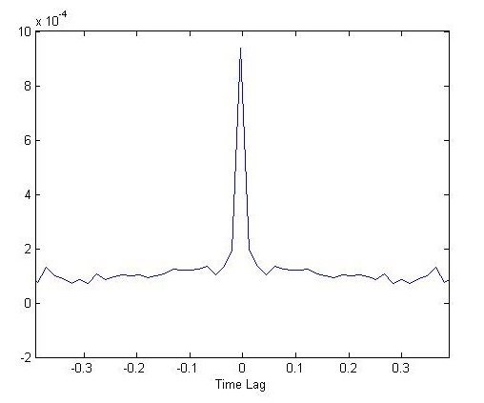
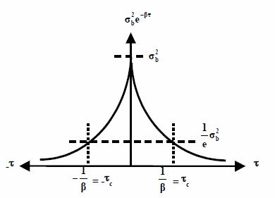
Proposed Feasibility Analysis of Low Cost Inertial Freehand Ultrasound Position Tracking
Ryan Anderson^{a,b}, Andras Lasso^{b}, Keyvan Hashtrudi-Zaadª, Gabor Fichtinger^{b,a}
ªDepartment of Electrical and Computer Engineering, Queen’s University, Kingston, Canada
^{b}Laboratory for Percutaneous Surgery, School of Computing, Queen’s University, Kingston, Canada
Introduction
Results
Background
Ultrasound is a popular medical imaging modality due to its low cost, safety and simplicity of use and setup. Combining ultrasound imaging with 3D tracking technology enables its use for tool guidance, volumetric image reconstruction, and other procedures.
Current tracking technology is mainly divided into optical and magnetic trackers.
Inertial tracking, common in the aerospace industry, offers another potential tracking solution.
Initial Simulation Results
Simulation results show that noise models approximately match error accumulation measured from actual sensor noise.
Over 100 seconds of simulation the noise models roughly follow the measured error accumulation, however all models tend to underestimate error, as shown in Figure 3.
Micro-electro-mechanical system (MEMS) based inertial measurement units (IMUs) can potentially provide tracking at costs an order of magnitude below current technology.
Objective
3mm position error required for volumetric reconstruction. Error must be maintained for 5+ minutes for tool tracking.
Volumetric reconstruction tracks only in a small workspace, as in Figure 1.
IMU tracking error could be compensated with a known magnetic field in the workspace.
To estimate and model compensation required, noise models can be used to
Figure 3. Measured and estimated long term error accumulations
Simulating the noise as Gaussian, with an autoregressive model, and as a Gauss-Markov process show they are capable of roughly approximating the measured noise.
The desired accuracy for tracked ultrasound is 3mm, and Figure 4 shows in an ideal case IMU error exceeds this bound in a few seconds, demonstrating the need for a correction to the position estimate.
Figure 1. Typical ultrasound workspaces for volumetric reconstruction [1]
characterize sensor performance.
Methodology
Performance Estimate and Noise Modelling
A baseline performance estimate was determined for a very low cost commercial MEMS-based IMU, the Phidget Spatial 3/3/3 [2].
Sensor noise was measured by collecting static data over 100 seconds.
Sensor noise was modelled as Gaussian noise, as a Gauss-Markov model, and as an autocorrelation (AR) sequence.
The Gauss-Markov model is a function of variance and the parameter β, which is determined from the autocorrelation sequence as shown in Figure 2.
Measured error accumulation and estimated was determined by integrating static acceleration data.
Desired Maximum Error
Figure 4. Measured and estimated short term error accumulations
Conclusions
From these preliminary results, it can be concluded that low cost sensors show promise for position estimation provided an intermittent correction to the position estimate can be provided at least every 3-5 seconds.
Modelling of the sensor noise provides a good characterization of the expected performance.
Future work will investigate further noise models and tuning models for better accuracy. Also, position correction requirements to compensate for the drift in IMU position estimations will be investigated.
Figure 2. Accelerometer autocorrelation and relation to statistical parameters [2]
Freehand Motion Collection
To measure dynamic error, freehand motion data will be collected with high accuracy position trackers such as that shown in Figure 3.
The data will be interpolated and smoothed to produce a simulated trajectory with little noise and a very high sampling rate.
Applying noise models to idealized trajectories will demonstrate the accuracy of an IMU with arbitrary noise values in tracking known trajectories.
References & Acknowledgements
[1] Aaron Fenster, Jeff Bax, Hamid Neshat, Nirmal Kakani and Cesare Romagnoli, “3D Ultrasound Imaging” in Image-Guided Intervention, Advancements and Breakthroughs in Ultrasound Imaging, 1st ed. 2013, ch 1, sec. 2.2.1, pp 4
[2] Sameh Nassar, Klaus-Peter Schwarz, Naser El-Sheimy and Aboelmagd Noureldin, “Modeling Inertial Sensor Errors Using Autoregressive (AR) Models, unpublished,
[3] Phidgets, Inc. Calgary, AB, Canada.
Ryan Anderson was supported by the Ontario Graduate Scholarship. G. Fichtinger was funded as a Cancer Care Ontario Research Chair.
Figure 3. Example of an IMU with added optical tracking markers

