Slide 1
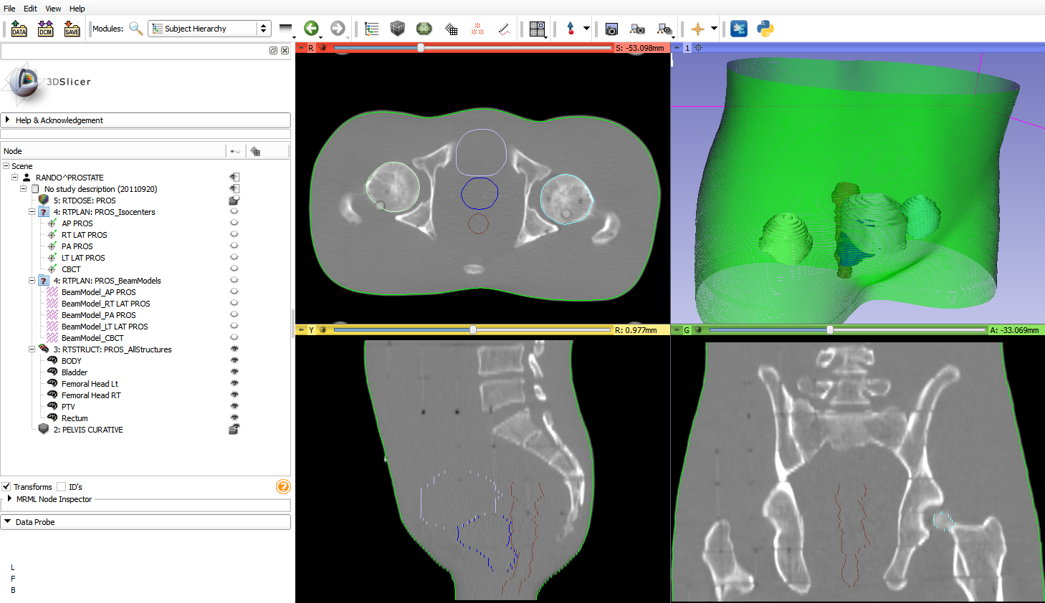
Cloud computing of anatomical similarity
Jennifer Andrea, Csaba Pinter, Gabor Fichtinger
Laboratory for Percutaneous Surgery, School of Computing, Queen’s University, Kingston, ON
Introduction
Results and discussion
Background
In image-guided interventions, anatomical structures are typically derived from medical images through segmentation. In radiation therapy, a previously computed treatment plan with the most similar anatomy to the current patient potentially helps to determine the optimal treatment plan parameters. Finding the treatment plan with the most similar anatomy is a performance-heavy and lengthy computation.
Objective
We propose to use the cloud to decrease the computation time of finding the most similar anatomical structure set by performing the similarity analyses in parallel.
The system was tested on 5 simulated datasets
To create different simulated datasets that were still similar, a patient CT with a pre-contoured structure set was transformed by random known parameters
Each study was presented to the system as the study under comparison and the system returned the correct result each time
The computation time was measured for three different setup configurations, for one to five studies (Fig. 2)
The cloud had the smallest computation time of the three configurations for two or more studies
The computation time for the cloud grew by 27.5 seconds on average, and would have an estimated computation time of less than 10 minutes for 10 studies
Methods
Platform and data
The similarity analysis computation was performed on Amazon Web Services (AWS) Elastic Cloud Compute instances, using 3D Slicer (www.slicer.org) and SlicerRT (www.SlicerRT.org) to perform the computation
3D Slicer is an open source platform for medical image analysis and visualization
SlicerRT is a radiation therapy research extension for 3D Slicer [1]
AWS Simple Storage Service and Simple Queue Service were used for storage of the previously computed structure sets and communication between the local computer and the cloud
The anatomical structure sets used in this work were CT scans and structure sets from synthetically created radiation treatment studies (Fig. 1)
Computation
The study under comparison was compared to each of the previously computed studies
In each comparison, the CT from the study under comparison was registered to the CT from the previously computed study, and the resulting transformation was applied to the structure set from the study under comparison
The Dice coefficient was computed for pairs of matching contoured structures following transformation
Figure 2. Length of time for treatment plan selection on different setup configurations. “Local automated” is the local computer using an automated workflow for computing the similarity, and “local manual” means manually performing the comparison using the SlicerRT graphical user interface on the local computer.
Conclusion
This system represents a new use of the cloud for finding the study with the structure set most similar to a given set. The decrease in computation time was significant when compared to similarity computations performed solely on the local computer. As contour comparison is lengthy and was only used for proof-of-concept, in the future raw anatomical data will be compared.
Acknowledgements
This work was co-funded as an Applied Cancer Research Unit of Cancer Care Ontario with funds provided by the Ontario Ministry of Health and Long-Term Care. Gabor Fichtinger was funded as a Cancer Ontario Research Chair.
References
[1] C. Pinter, A. Lasso, A. Wang, D. Jaffray, and G. Fichtinger, "SlicerRT: Radiation therapy research toolkit for 3D Slicer", Med. Phys. 39(10), 6332/7 (2012).
Figure 1. One of the simulated radiation treatment studies, consisting of a CT scan and structure set.

