Slide 1
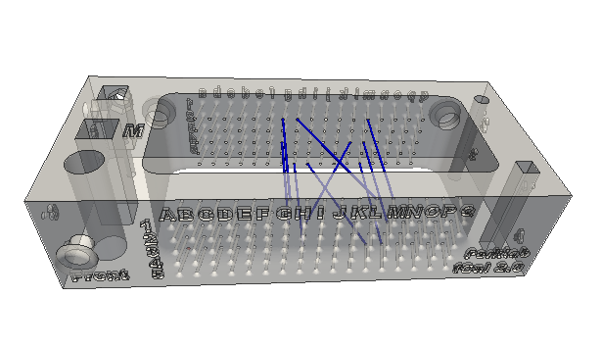
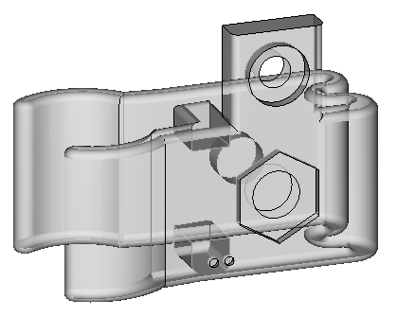
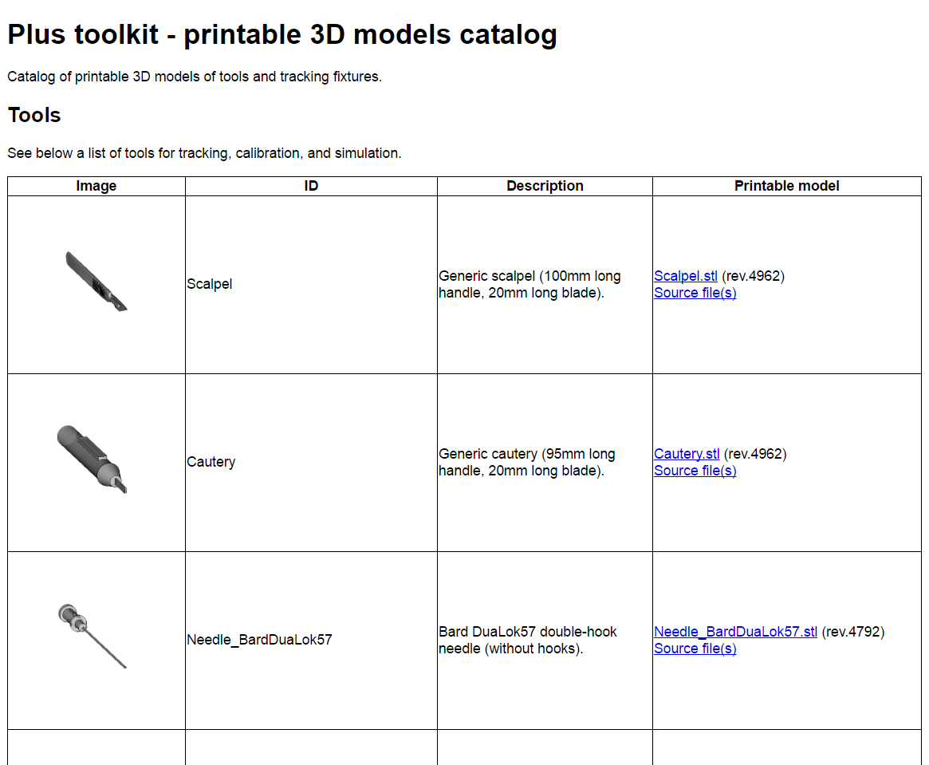
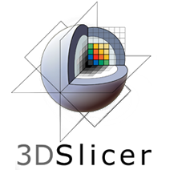
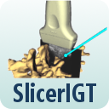


PLUS Model Catalog: A library of 3D-printable models
Eden Bibic, Zachary Baum, Vinyas Harish, Tamas Ungi, Andras Lasso, Gabor Fichtinger
Laboratory for Percutaneous Surgery, School of Computing, Queen’s University, Kingston, ON
Introduction
Results
3D-printed tools are becoming commonplace in computer-assisted interventions for calibration, treatment planning, simulation, and instrument tracking.
The PLUS Toolkit is an open-source platform which supports development of computer-assisted interventions (Lasso et al., 2014).
PLUS Model Catalog is an online file library of 3D-printable models for public use with the PLUS Toolkit.
The PLUS Toolkit is downloaded approximately 1,500 times per year, becoming a widely-used platform in computer-assisted interventions.
PLUS Toolkit has been cited over 70 times (Google Scholar).
Catalog contains 34 models; it is regularly expanded and new models are created upon request.
Users access the Model Catalog as their resource for tracking fixtures and other 3D-printable surgical tools.
Demonstrated applications
Methods
Creating models
Computer-Aided Design (CAD) software is used to make models of different tools.
Models are then printed, tested, and reiterated if necessary.
Distributing models
STereoLithography (STL) files and any accompanying files are uploaded to the catalog in the PLUS Toolkit.
Each file is accompanied by a model description and an image that shows the recommended printing orientation.
The catalog updates with the most recent content on a nightly basis and is displayed in the PLUS Toolkit as a static webpage (Fig. 1).
Using models
As with the PLUS Toolkit, the catalog is freely accessible.
The most recent versions of all models are available for use and modification in research and clinical applications.
The models may be imported and displayed in 3D Slicer, by using the PLUS Model Catalog within the SlicerIGT extension or by downloading and importing the STL file.
Catalog contains N-Wire calibration phantoms for tracked ultrasound systems (Fig. 2).
N-Wire phantoms provide consistently precise and accurate calibrations (Carbajal et al., 2013).
Mounting fixtures for position-tracking sensors for a several surgical tools are also available (Fig. 3).
Catalog models can be used in 3D Slicer applications for visualization in computer-assisted interventions (Fig 4).
Fig. 2. N-Wire ultrasound calibration phantom (Carbajal et al., 2013)
Fig. 3. Electromagnetic tracking sensor holder for surgical cautery (Ungi et al., 2016)
Fig. 4. 3D Slicer navigation scene with catalog models of tracked ultrasound, needle, and spine
Conclusion
The Catalog enhances the PLUS Toolkit through promotion of rapid development of 3D models for clinical translation of computer-assisted intervention applications.
References
Fig. 1. PLUS Toolkit 3D Model Catalog webpage
[1] Lasso et al. "Plus: Open-source toolkit for ultrasound-guided intervention systems", IEEE TBME 2014.
[2] Carbajal et al. “Improving N-wire phantom-based freehand ultrasound calibration”, IJCARS 2013.
[3] Ungi et al. “Navigated Breast Tumor Excision Using Electromagnetically Tracked Ultrasound and Surgical Instruments”, IEEE TBME 2016.
www.slicer.org
www.plustoolkit.org
www.slicerigt.org

