Slide 1
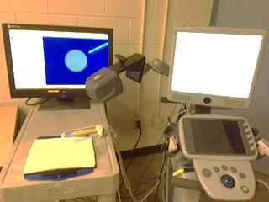
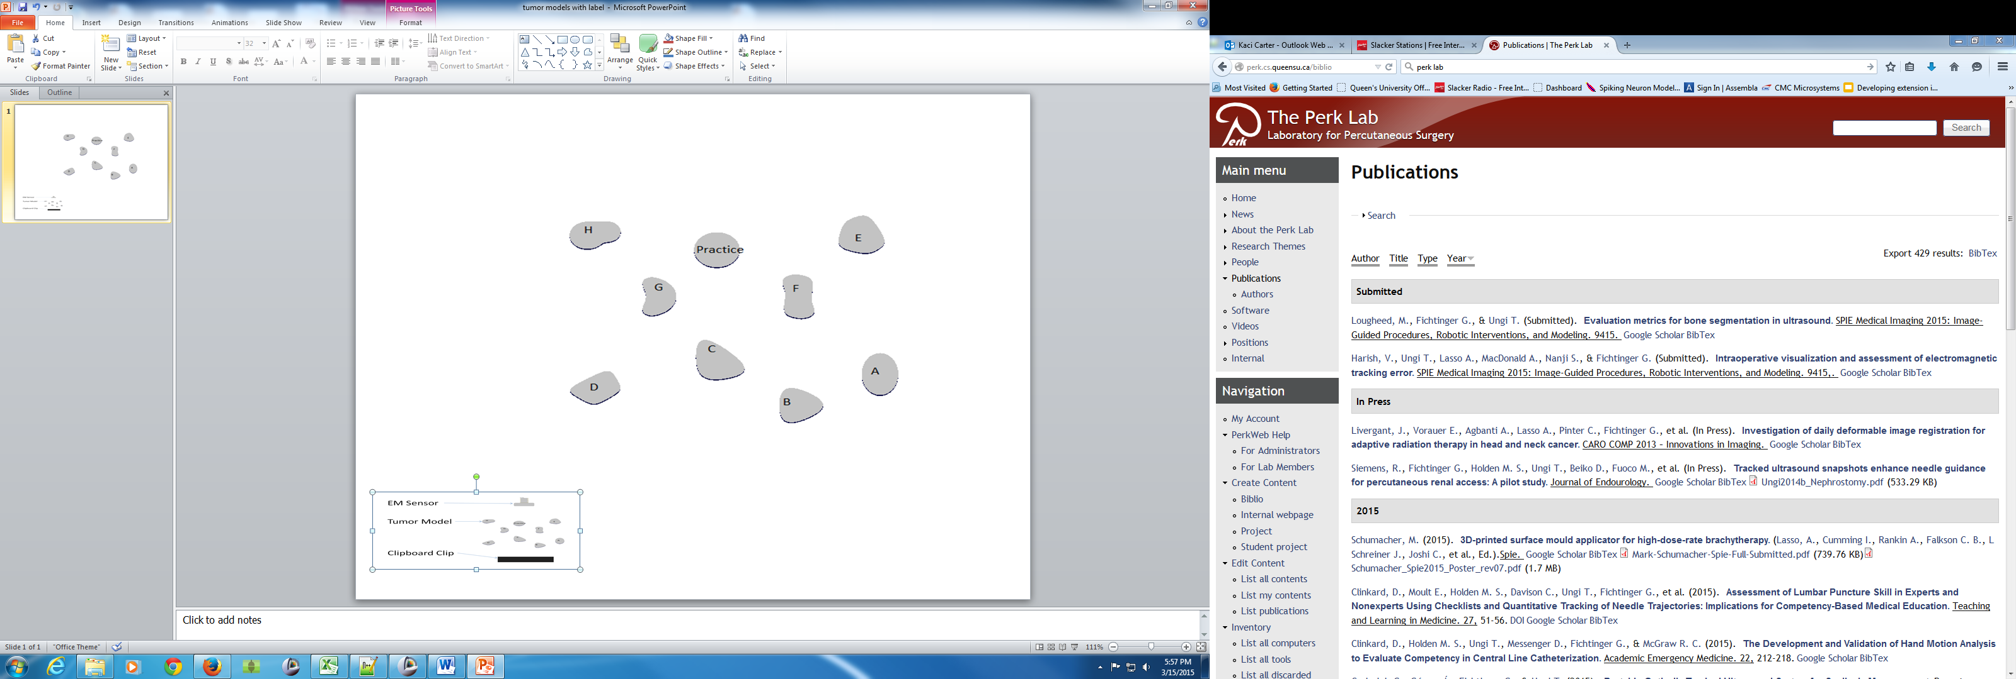
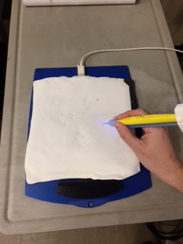
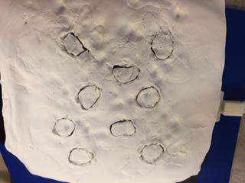
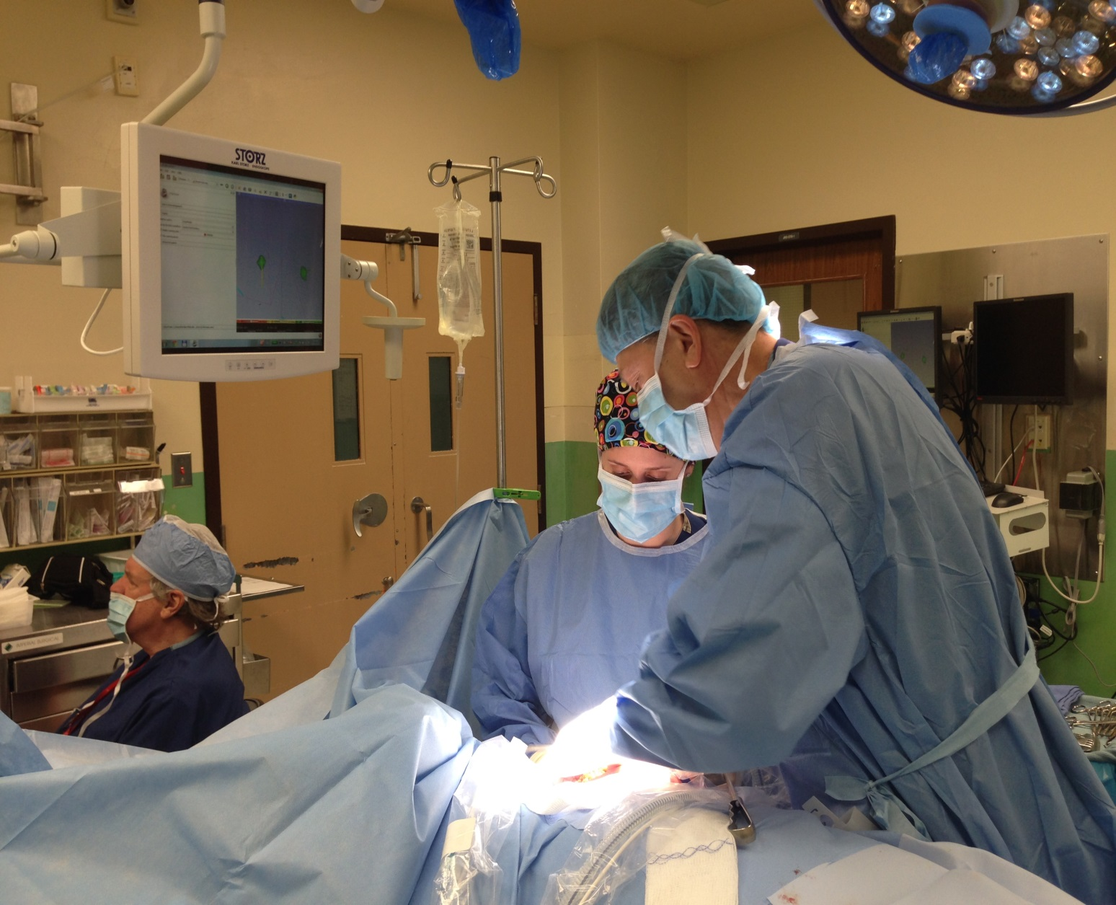
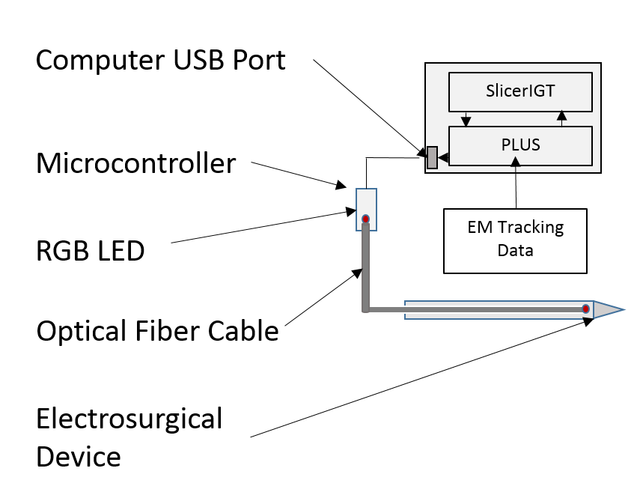
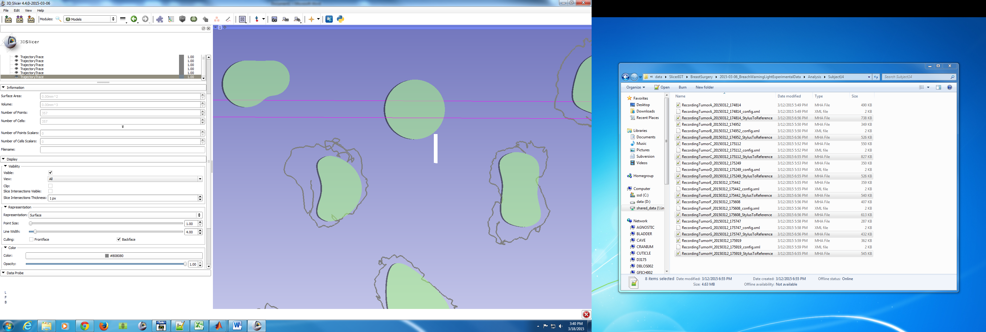
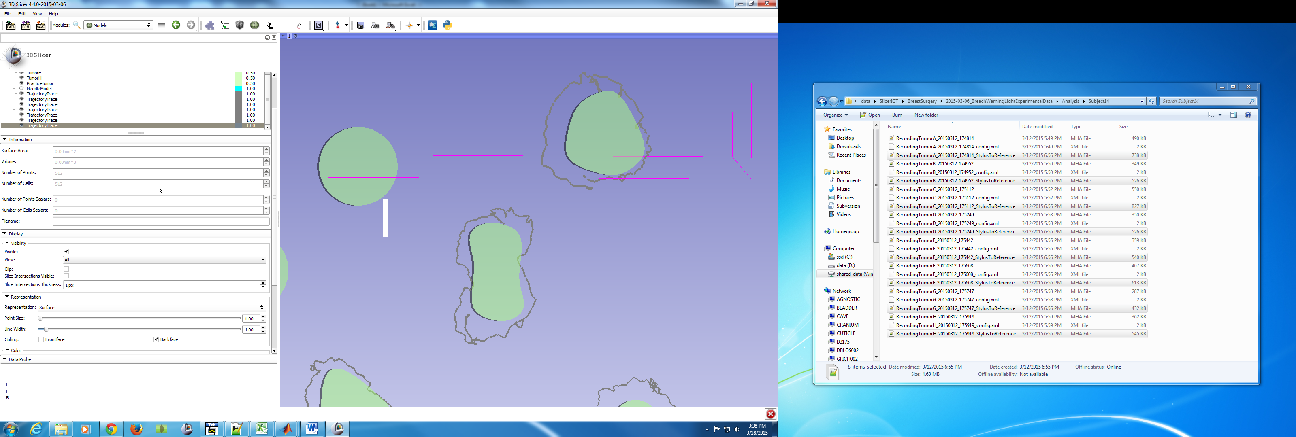


Visual feedback mounted on surgical tool
K. Carter, T. Vaughan, G. Gauvin, P. Pezeshki, A. Lasso, T. Ungi, E. Morin, J. Rudan, C. J. Engel, G. Fichtinger
Queen’s University, Kingston, Canada
Introduction
The subjects performed two sets of 4 random tumor contours, first using 3D screen alone and then with 3D screen combined with LED feedback
Motivation
In the operating room (OR), instrument position relative to the relevant anatomical structures is typically displayed on a computer monitor external to the tracked tool
The surgeon’s attention is primarily focused on the tool and the surgical site, resulting in the display not being in a direct line of sight
Objective
The objective is to develop a visual feedback mechanism that will be mounted on the surgical tool and thus within the surgeon’s direct line of sight
This visual feedback system will be used to alert the surgeon when it is necessary to consult the monitor for detailed navigation information
Experimental setup (left), computer model of the tumor contours (center left), surgeon cutting out a tumor with the LED-mounted tracked cauterizer (center right), result after cutting out all tumors from the clay dough (right)
Results and Discussion
The questionnaires from all 13 participants show a statistical increase in the confidence to recognize tumor margins and a statistical decrease in the need to look at the screen when the LED provided feedback
The tracked data was analyzed for the surgical residents only owing their relevant surgical experience
  The residents stayed within acceptable margins (1-5mm) more frequently, removed less healthy tissue, but tended to stray more into the tumor with the LED feedback than without.
  The recreation of the cutting path shows that the LED combined with the 3D screen reduced the amount of healthy tissue within the cut
Current OR layout in electromagnetically (EM) tracked electrosurgery [1]
Methods
Design
A computer controlled light source (RGB LED) is programmed to flash and change color to gain the surgeons attention
A variety of colors and flashing frequencies were explored to determine the most effective pattern
An optical fiber cable is used to transmit the light to the tracked surgical device in order to reduce EM noise and avoid a galvanic connection to the patient
A sample recreation of the cutting path around a tumor; 3D screen only (left) and 3D screen + LED (right)
Schematic of the visual feedback system
Combined surgical distance from tumor boundaries
System integration
An Arduino Uno microcontroller communicates with the computer interface through a serial USB connection
The device is integrated in to the SlicerIGT open source surgical navigation system
Tool tracking functions are implemented using the PLUS toolkit [2]
Our visual feedback device also uses the PLUS toolkit to communicate information from SlicerIGT to the microcontroller
Experimental design
Soft modelling clay was laid out on a flat surface to simulate tissue
Two general surgery residents and 11 biomedical trainees were asked to resect simulated tumors using electro-magnetic surgical navigation with and without visual light feedback on the cauterizer
Different light and frequency patterns were chosen for four resection regions, relative to the tumor margin (inside the tumor, safety region, outside of the safety region, too far from tumor margin)
Conclusion
The results from this study shows good potential for the visual LED feedback, and with additional training, this approach may lead to an improved resection, with fewer cuts into the tumor and less healthy tissue removed; all to be explored in a larger study involving more surgical residents and attending surgeons
References
[1] G Gauvin et al., "Real-Time Electromagnetic Navigation for Breast Tumor Resection: Proof of Concept," in The 7th Hamlyn Symposium on Medical Robotics, 2014, Guang-Zhong Yang and Ara Darzi (Eds.) pp. 39-40, 2014.
[2] A Lasso et al., “PLUS: open-source toolkit for ultrasound-guided intervention systems.” IEEE Trans Biomed Eng. 2014 Oct;61(10):2527-37.
Acknowledgments: This work was funded by Cancer Care Ontario through the Applied Cancer Research Unit and the Research Chair in Cancer Imaging grants.

