Slide 1
Visual Feedback Mounted on Surgical Tool
K. Carter, T. Vaughan, P. Pezeshki, G. Gauvin, A. Lasso, T. Ungi, E. Morin, J. Rudan, C. J. Engel, G. Fichtinger

Slide 2
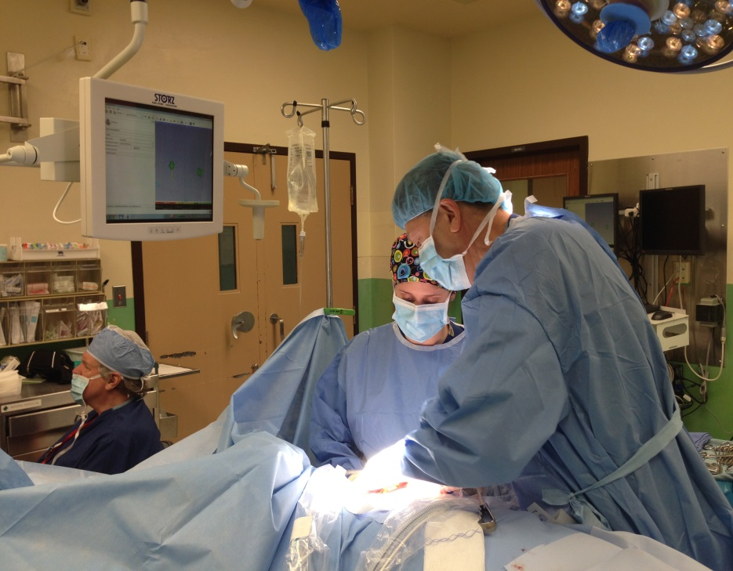
Research Problem
Computer monitor for navigation system
Current navigation system for electrosurgery provides feedback on a computer monitor
When the surgeon is focused on the surgical site, the computer monitor is out of the field of view
Notes:
Currently, electrosurgical devices can be tracked during surgery. The feedback for the position tracking is displayed on a computer monitor that is out of the surgeons direct line of sight.
Sub-optimal
-mention why you have to look at the surgical site (bleeding, tissue boundaries, etc)

Slide 3
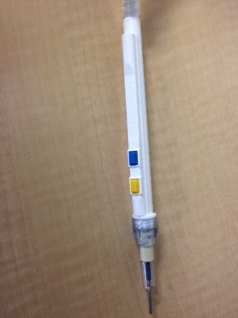
Objective
Develop a visual feedback device that will be mounted on an electromagnetically (EM) tracked electrosurgical tool to provide navigation information for the surgeon in the field of view
Notes:
Design Criteria:
No galvanic connection to patient
EM compatible
Light weight

Slide 4
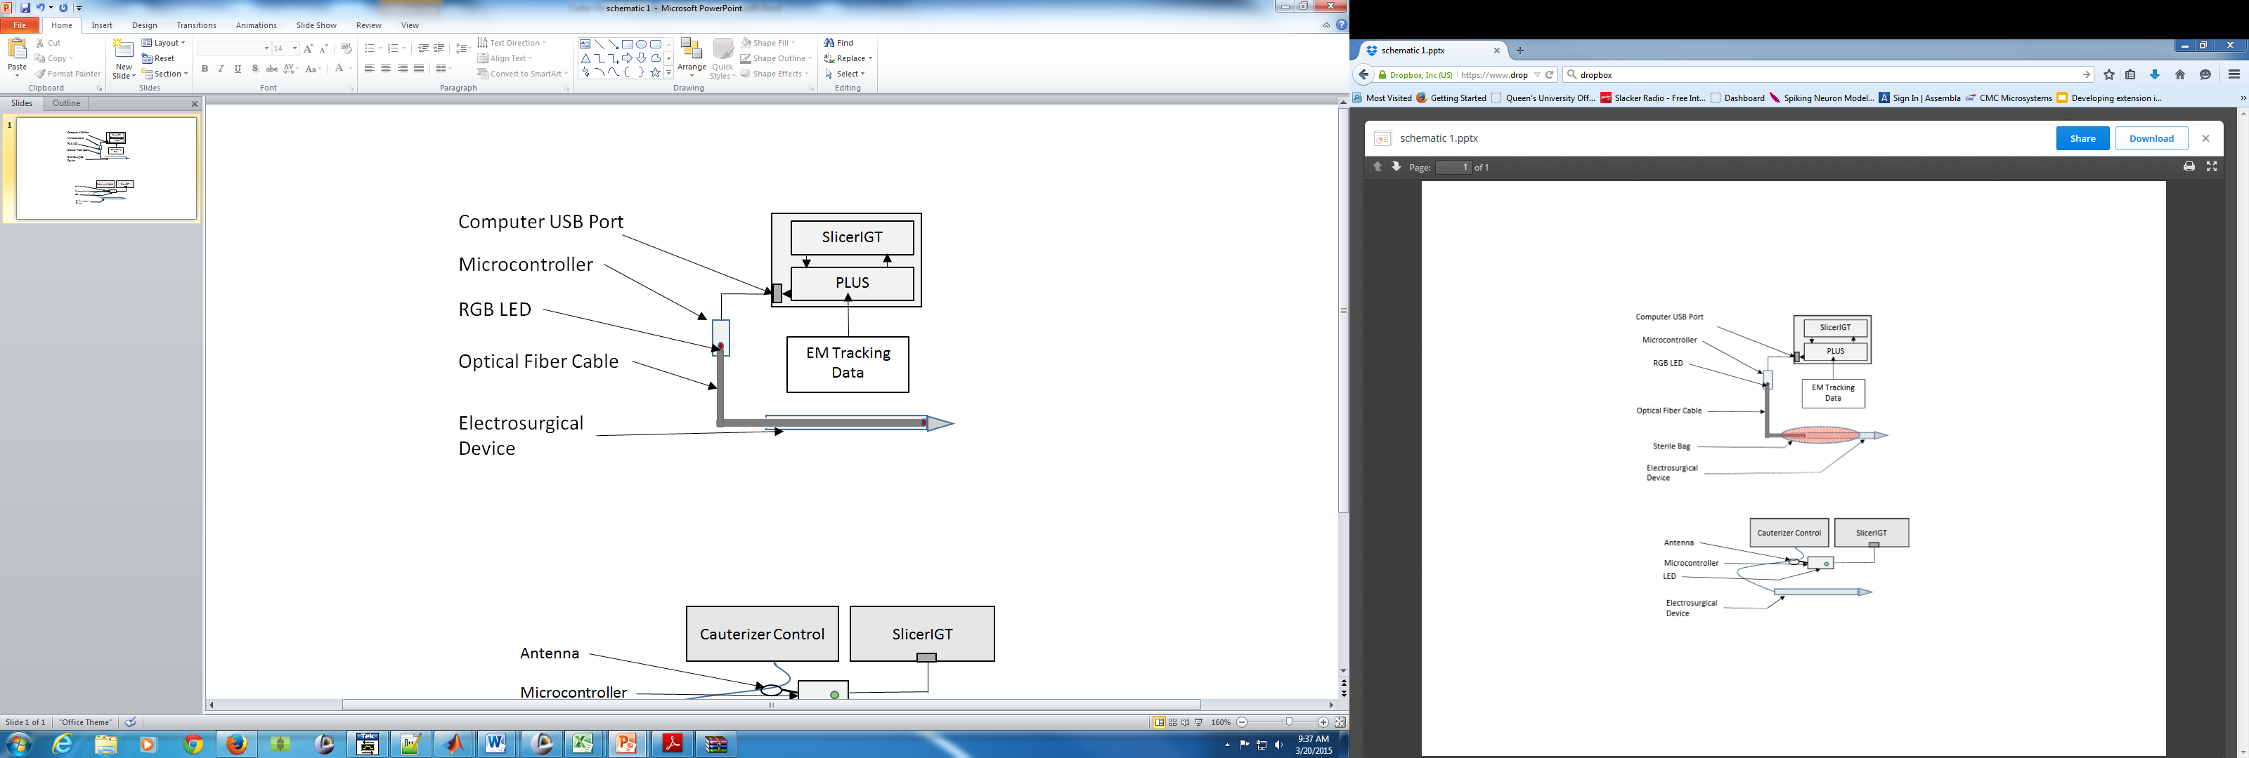
Design
www.SlicerIGT.org www.plustoolkit.org
Notes:
So the surgeon knows when to look at the monitor for detailed navigation information
RGB LED is programmed to flash and change color to obtain the surgeon’s attention
Integrated in the SlicerIGT open source surgical navigation system
PLUS toolkit
Tool tracking functions
Communicate information from SlicerIGT to a microcontroller

Slide 5
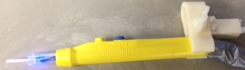
Visual Feedback
LED
Inside Tumor
Flashing red
Safety Region
Solid green
Outside of Safety Flashing green
Too Far
Solid Blue

Slide 6
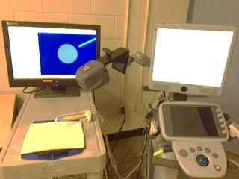
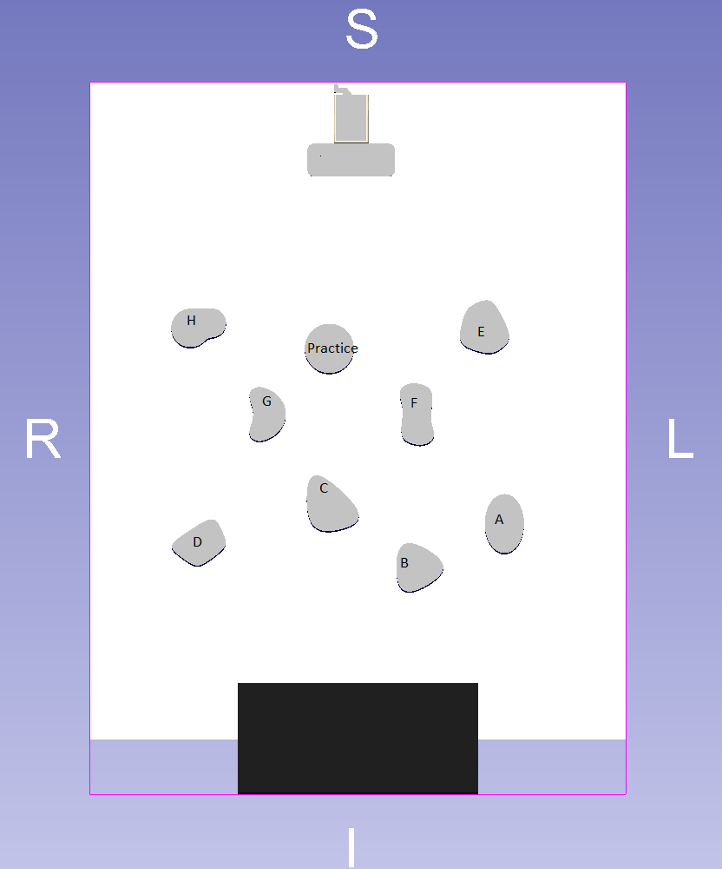
Demonstration of Concept
Determine if the tool-mounted visual feedback is useful adjunct to the surgical navigation system
13 volunteer participants (11 biomedical trainees and 2 surgical residents) resected simulated tumors with and without visual light feedback on the electrosurgical instrument
Notes:
Two general surgery residents were asked to resect simulated tumors using electro-magnetic surgical navigation with and without visual light feedback on the cauterizer
-so as to stay within acceptable margins (set to 2mm from tumor margin) and minimize the amount of healthy tissue contained within the cut

Slide 7
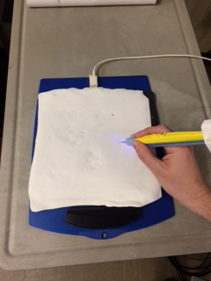
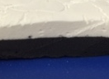
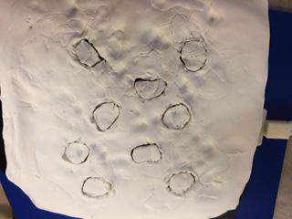
Demonstration of Concept
Resected 4 random tumors with the 3D surgical navigation alone and 4 with 3D surgical navigation combined with LED feedback
Notes:
-they were asked to cut the tumor contours out on the top layer of the clay without cutting the bottom layer (represents a tissue boundary)

Slide 8
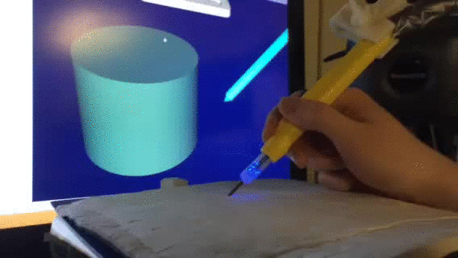
Prototype

Slide 9
Data Collection
All 13 participants completed a questionnaire to assess if they perceived that the LED feedback helped them follow the surgical margins
The tracked data were analyzed for the surgical residents only owing their relevant surgical experience
Notes:
The PerkTutor is an open-source computer-assisted training platform that provides visualizations of images, as well as automatically provides skill evaluation to medical trainees. In this work, we used the PerkTutor to automatically analyze operators’ cauterizer motion to determine how well they followed the tumor margins.
The questionnaires from all 13 participants show a statistical increase in the confidence to recognize tumor margins and a statistical decrease in the need to look at the screen when the LED provided feedback
The tracked data was analyzed for the surgical residents only owing their relevant surgical experience

Slide 10
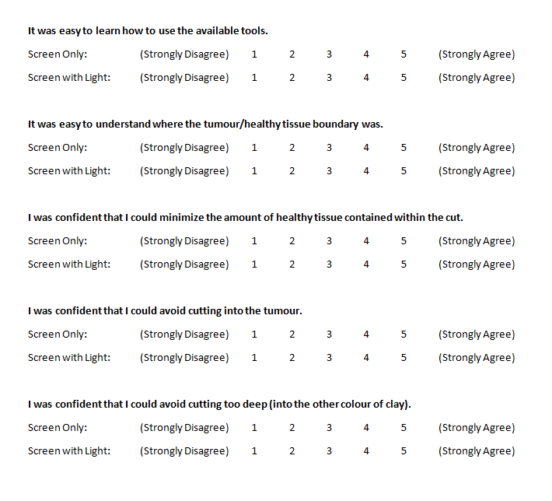
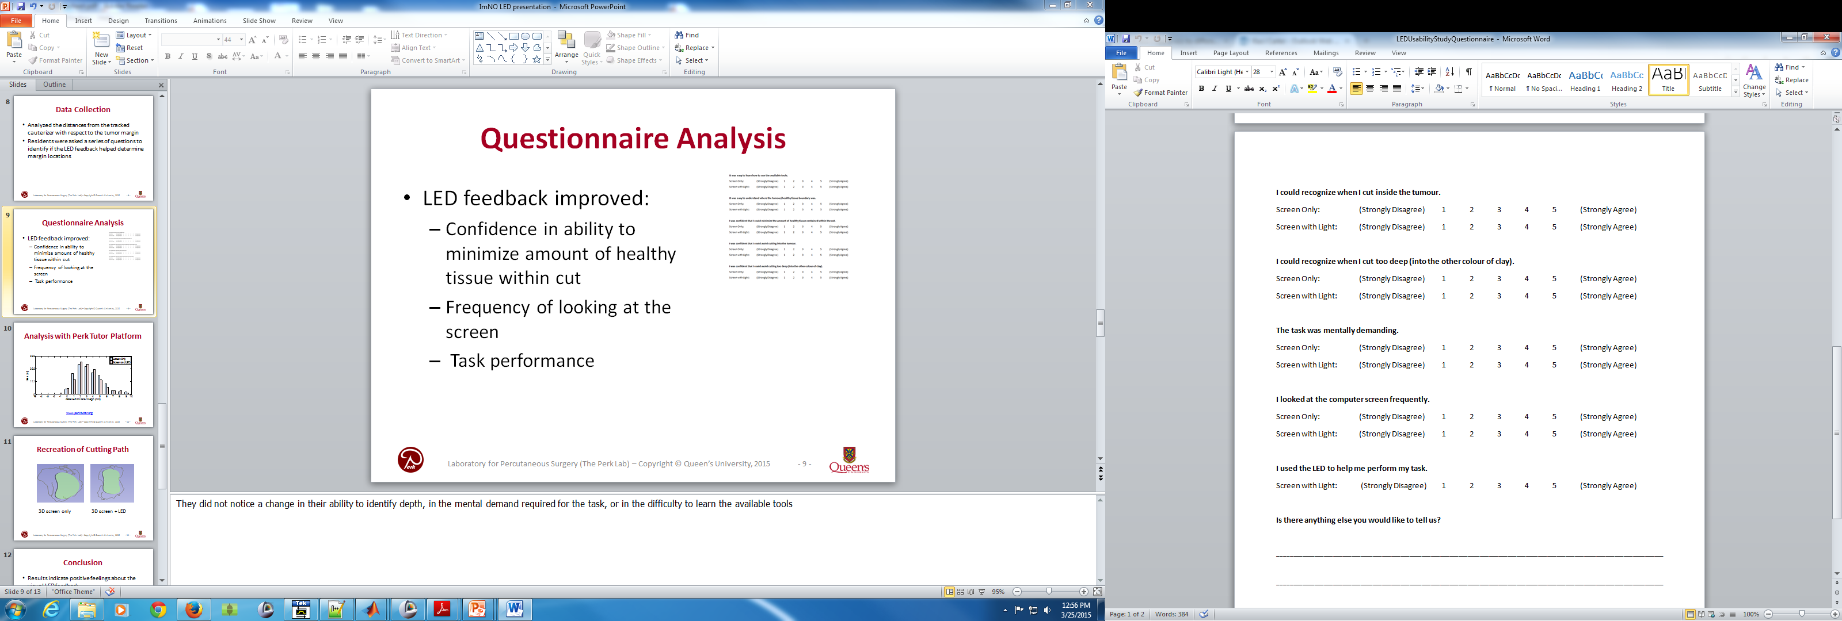
Questionnaire Analysis
Questionnaire responses showed:
  With LED feedback: a statistical increase in confidence to recognize tumor margins and a statistical decrease in the need to look at the surgical navigation monitor
  The LED was perceived to be useful in performing the required task
Notes:
They did not notice a change in their ability to identify depth, in the mental demand required for the task, or in the difficulty to learn the available tools
The questionnaires from all 13 participants show a statistical increase in the confidence to recognize tumor margins and a statistical decrease in the need to look at the screen when the LED provided feedback
The tracked data was analyzed for the surgical residents only owing their relevant surgical experience

Slide 11
Analysis with Perk Tutor Platform
www.perktutor.org
Notes:
Does not have statistical power due to the small number of participants recruited
-combined surgical distance from tumor boundaries
-the residents stayed within acceptable margins (2-5mm) more frequently with the LED feedback than without. The residents also removed less healthy tissue, but tended to stray more inside the tumor.
-The small margin size of 2mm may have been a cause of the increased straying. Therefore, increasing the acceptable margin size to 5mm may help minimize this tendency to move inside the tumor contour.

Slide 12
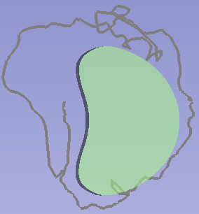
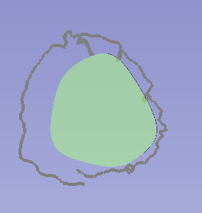
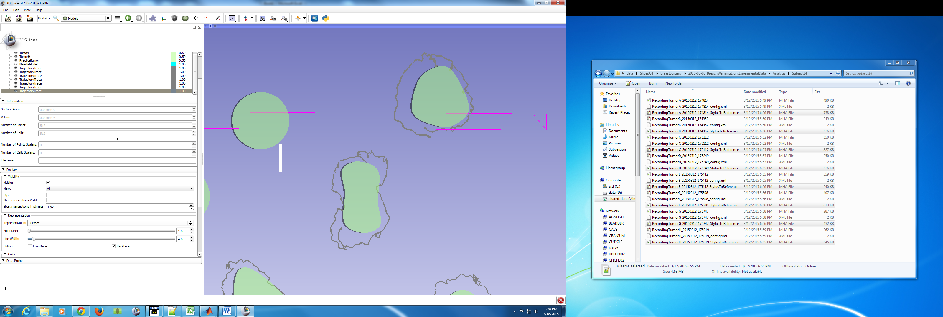
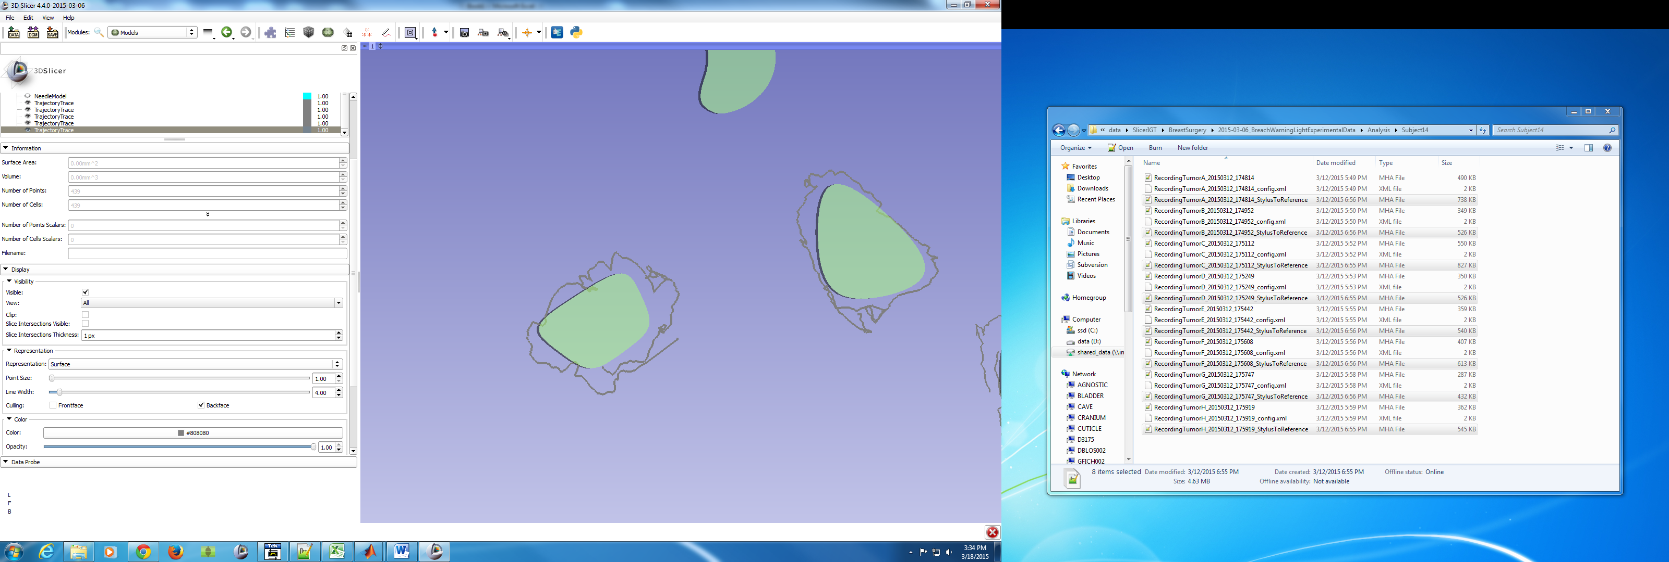
Recreation of Cutting Path
3D screen only
3D screen + LED

Slide 13

Conclusion
Results from this study shows good potential for using visual LED feedback in combination with surgical navigation
This approach may lead to an improved resection, with fewer cuts into the tumor and less healthy tissue removed
Notes:
-with additional training it may lead to improved
-all to be explored in a larger study involving more participants with a focus on analyzing path length in each of the various distances from the tumor margin

