Slide 1
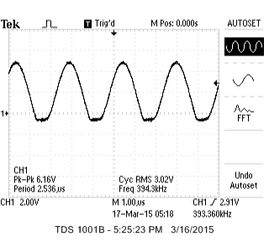
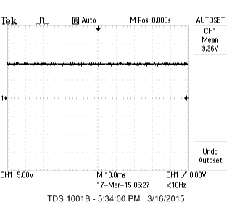
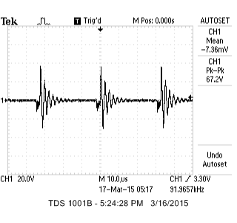
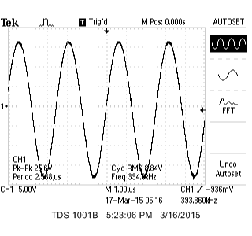
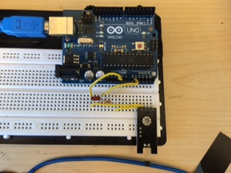
Current sensing for navigated electrosurgery
Kaci Carter^{1,2}, Andras Lasso¹, Tamas Ungi¹, Evelyn Morin², Gabor Fichtinger^{1,2}
¹ Laboratory for Percutaneous Surgery, School of Computing, Queen’s University, Kingston, ON, Canada
²Department of Electrical and Computer Engineering, Queen’s University, Kingston, ON, Canada
Introduction
Results and Discussion
Motivation
Tracked power tools are routinely used in computer-assisted intervention and surgical systems
It is necessary to know when a tracked power tool (electrosurgical cauterizer) is being powered on in order to properly perform temporal and spatial monitoring of the tracked tool
Objective
The objective is to implement a general purpose current sensor that can be augmented to tracked surgical devices to inform the surgeon and the navigation system when the tool is powered on
When the cauterizer is powered on in either the cut or coagulation mode, the waveform shown in Fig. 3 is observed at the output pin of the Hall effect switch
When the cauterizer is not applying a signal, the detected voltage is 0V
An output dc voltage was obtained at the output of the filter when the cauterizer was on in 60W coagulation mode or 60W cut mode (Fig. 4)
The Arduino Uno microcontroller, recognizes that the cauterizer is being powered on when the dc voltage is greater than the threshold voltage
Fig. 5 shows the integration of the Hall effect switch with the LP filter and Arduino Uno microcontroller
Fig. 3: Output waveform of the A3144E switch
Methods
Initial Exploration
Initial testing was performed using an oscilloscope in close proximity to a electro-cautery device (Valleylab Force FX, Boulder CO)
Fig. 1 shows the different waveforms produced by the cautery device when on coagulation and cut mode
Fig. 4: DC signal produced on output of filter
LED
Fig. 1: Coagulation mode (left), cut mode (right)
Microcontroller
LP Filter
A3144E Switch
Fig. 5: Prototype of current sensing device
Power Cable
Design Criteria
Clinically applied power tools are approved by FDA and/or Health Canada
An electrically isolated sensing and feedback system is required that does not interfere with the tool and is compatible with electromagnetic tracking
Conclusion
Current Sensing
The schematic of the current sensing feedback system is shown in Fig. 2
A Hall Effect switch (A3144E, allegromicro.com) has been placed nearby the power cable of the electrosurgical cautery device
The switch senses the magnetic field produced by the cable that supplies the current to the electrosurgical device
The output waveform produced by the switch is fed into a single-pole RC low pass (LP) filter where the output of the filter is a constant dc voltage
The dc voltage is sampled by the Arduino Uno microcontroller (arduino.cc), which is programmed to turn on an LED when the voltage level goes above a specific threshold to provide visual confirmation for the surgeons that current is flowing into the electrosurgical device
A current sensing device has been designed for determining when a tracked cauterizer is powered on
In the future, a new design will be developed to differentiate between the cut and coagulation modes of the cauterizer
This device is currently being implemented and tested within the context of EM-navigated breast-conserving surgery [1]
The Plus library [2] will be used to properly integrate the detector into the surgical navigation system and temporally calibrate the electrosurgical device
References
Fig. 2: Schematic of the current sensing feedback system
[1] G Gauvin et al., "Real-Time Electromagnetic Navigation for Breast Tumor Resection: Proof of Concept," in The 7th Hamlyn Symposium on Medical Robotics, 2014, Guang-Zhong Yang and Ara Darzi (Eds.) pp. 39-40, 2014.
[2] A Lasso et al., “PLUS: open-source toolkit for ultrasound-guided intervention systems.” IEEE Trans Biomed Eng. 2014 Oct;61(10):2527-37.
Acknowledgments: This work was funded by Cancer Care Ontario through the Applied Cancer Research Unit and the Research Chair in Cancer Imaging grants.

