Slide 1
Current Sensing for Navigated Electrosurgery
K. Carter, A. Lasso, T. Ungi, E. Morin, G. Fichtinger

Slide 2
Research Problem
Physiological and pathological monitoring
Temporally and spatially monitor the tracked electrosurgical tool
Balog et al., "Intraoperative tissue identification using rapid evaporative ionization mass spectrometry," Science translational medicine, vol. 5, no. 194, pp. 194ra93--194ra93, 2013.
Notes:
-smoke is taken into mass spectrometer where the chemical make up is analyzed
-results can then be immediately analyzed and can be told the physiological and pathological properties of the tissue being cut into

Slide 3
Objective
To implement a current sensor that can be integrated with a tracked electrosurgical device to inform the navigation system when the tool is powered on
Notes:
Visual aid ?
-distinguish design criteria in terms of font or format
-led is for testing purposes
Design objective:
Compatible with electromagnetic (EM) tracking
Electrically isolated

Slide 4
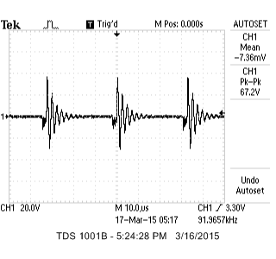
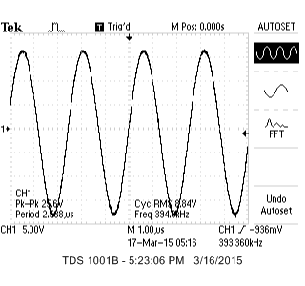
Initial Exploration
Coagulation mode
Cut mode

Slide 5
Design
Notes:
A Hall Effect switch (A3144E) has been placed nearby the power cable of the electrosurgical cautery device
The switch senses the magnetic field produced by the cable that supplies the current to the electrosurgical device
The output waveform produced by the switch is fed into a low pass (LP) filter where the capacitor is used to create a constant DC output voltage
The DC voltage is then fed into the analog input pin of the Arduino Uno microcontroller, which is programmed to turn on a LED when a specific voltage is received to provide visual confirmation for the surgeons that current is flowing into the electrosurgical device
-mention how integrating into plus system with SlicerIGT

Slide 6
A3144E Hall Effect Switch
Voltage regulator
Reverse battery protection diode
Quadratic Hall-voltage generator
Small signal amplifier

Slide 7
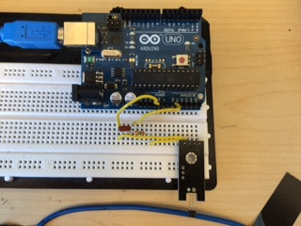
Prototype
LED
Microcontroller
LP Filter
A3144E Switch
Cable
Notes:
Cable delivers current to electrosurgical tool

Slide 8
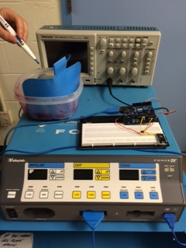
Test Bed
Tested using electrosurgical unit and oscilloscope
Tested power ratings of 30W and 60W for monopolar cut and coagulation modes
Varied distance between cable and sensor
Notes:
-put in a pic here of cautery machine and jello/grounding pad

Slide 9
Results: output waveforms
Hall Effect Switch
Low Pass Filter
Arduino Uno
Hall effect switch output when electrosurgical unit is on (top) or off (bottom)
Low pass filter output when electrosurgical unit is on (top) or off (bottom)

Slide 10
Results: sensor placement
Power rating (W) | Sensor distance from cable (inches) | Cut mode dc voltage (V) | Coagulation mode dc voltage (V)
30 | 0 | 4.35 | 2.08
 | 3 | 1.45 | 1.27
60 | 0 | 6.02 | 2.85
 | 3 | 1.76 | 1.61
Notes:
-3 inches was optimal since it allows for the sterile bag to be around the power cable, it produces dc voltages that are within acceptable ranges for input to Arduino, also the dc voltage of 6 and 12 inches are getting too small and noise is becoming more evident in the signals

Slide 11
Conclusion
Currently can detect when device is powered on/off and can differentiate between the cut and coagulation modes of the electrosurgery unit
The circuit design will be improved to minimize the number of components and be robust to different electrosurgical units
Notes:
The Plus library [2] will be used to properly integrate into the surgical navigation system and temporally calibrate the electrosurgical device

