Slide 1
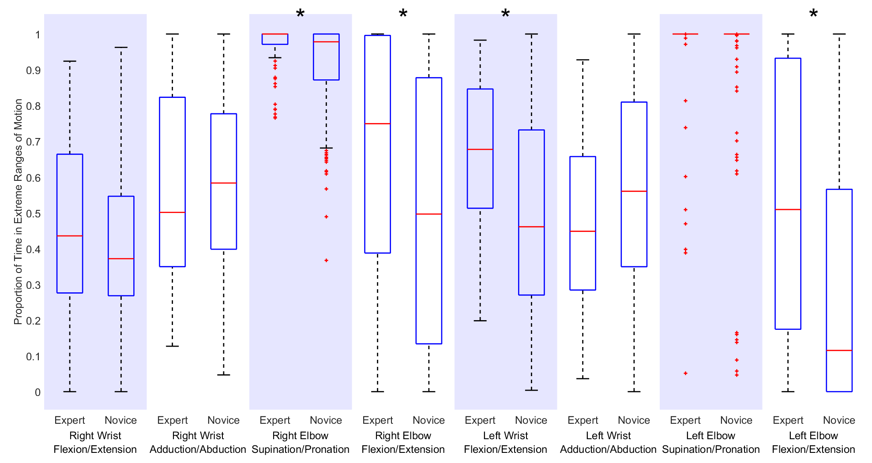
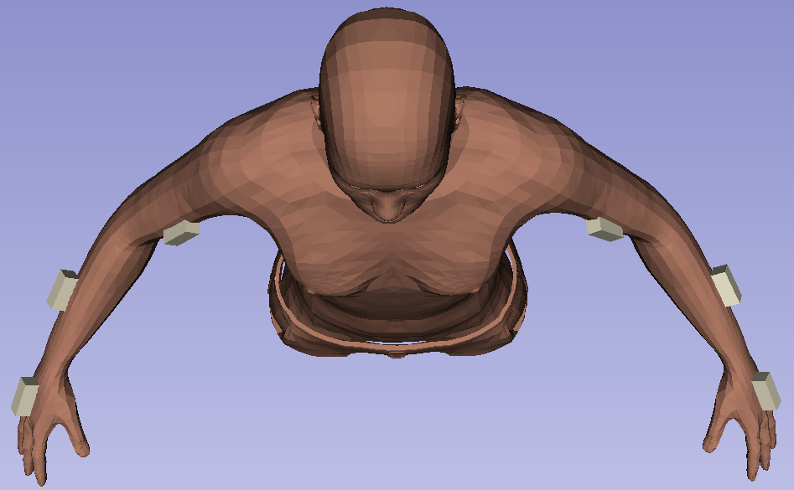
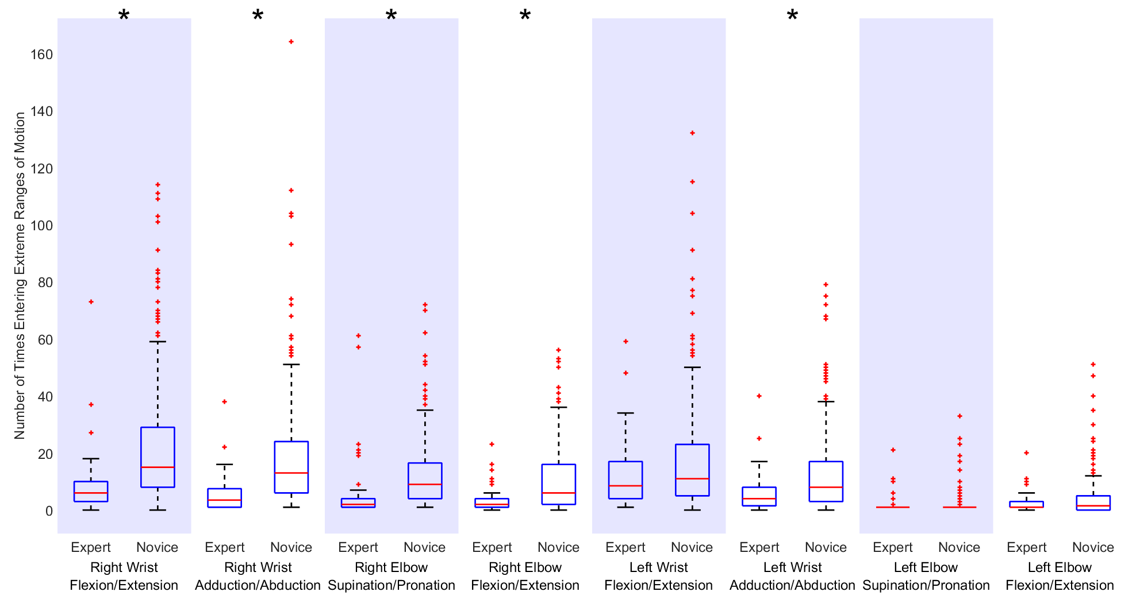
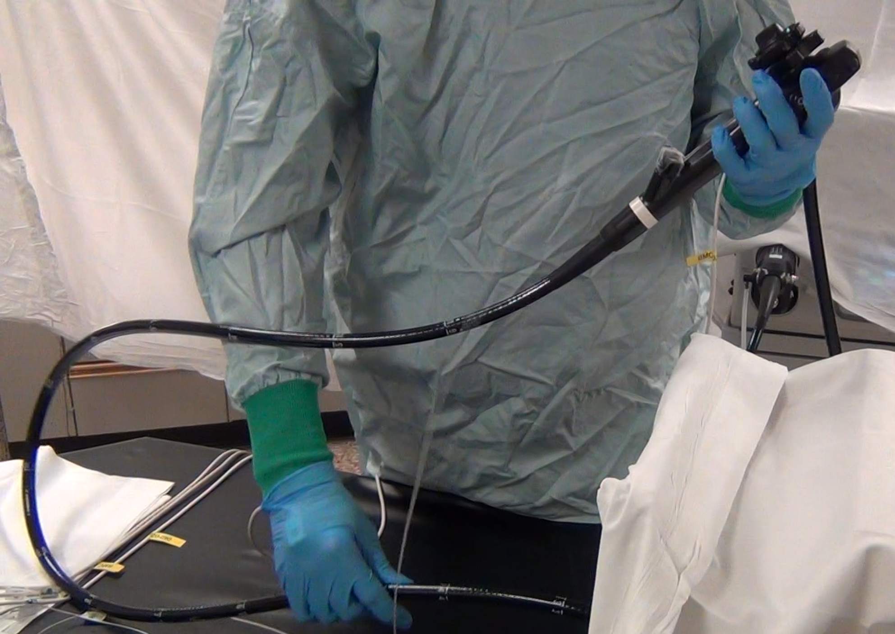
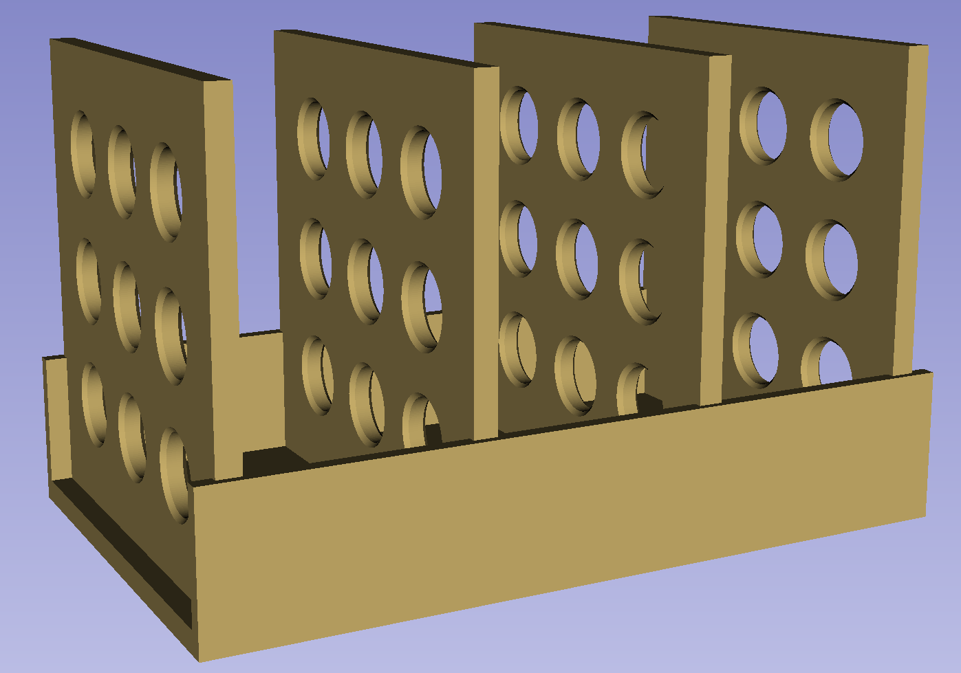



Assessing Technical Competence in Simulated Colonoscopy Using Joint Motion Analysis
Matthew S. Holden¹, Chang Nancy Wang², Kyle MacNeil¹, Ben Church¹, Lawrence Hookey², Gabor Fichtinger¹, Tamas Ungi¹
¹Laboratory for Percutaneous Surgery, School of Computing, Queen’s University, Kingston, ON, Canada
²Gastrointestinal Diseases Research Unit, Department of Medicine, Queen’s University, Kingston, ON, Canada
Introduction
Results
It is essential that trainees learn colonoscopy technical skills prior to real patient encounters [1].
Mastering these skills requires spatial awareness and the coordination of scope insertion with steering, using a rotating image for reference.
The objective of this work was to determine whether joint motion analysis is a feasible method for assessing colonoscopy technical skills in a simulated environment.
Experts performed more efficient procedures than novices, taking significantly less time and making significantly fewer hand motions.
Experts spent more time in extreme ranges of motion (Fig 3).
Novices entered extreme ranges of motion more often (Fig 4).
Methods
Joint Motion Analysis
Sensors were affixed to operators’ hands, forearms, and biceps (Fig 1).
Following calibration, we computed performance metrics based on the angular measurements from the wrists and elbows.
Study Protocol
Novice medical students and expert gastroenterologists scoped a low-fidelity colon model [2].
Following several practice sequences, participants were evaluated using joint motion analysis on four scoping sequences (Fig 2).
Joint motion analysis was computed using the open-source Perk Tutor (www.perktutor.org) software for image-guided intervention training.
Proportion of Time in Extreme Ranges | The proportion of time a joint is in an extreme range of joint motion
Number of Entries into Extreme Ranges | The number of times a joint enters into an extreme range of joint motion
Fig 3. The proportion of time expert and novice operators spent in extreme ranges of motion (asterisk indicates a significant difference).
Fig 1. Illustration of sensor positions (indicated in white) on operators’ arms.
Fig 4. The number of times expert and novice operators entered extreme ranges of motion (asterisk indicates a significant difference).
Conclusion
Novices and experts exhibited different joint movement patterns, indicating that joint motion analysis is feasible for assessment and feedback in the context of computer-assisted intervention training.
Further analysis is required to determine whether it can be used to reliably quantify competence in colonoscopy.
References & Acknowledgements
[1] J. B. Marshall, "Technical proficiency of trainees performing colonoscopy: A learning curve," Gastrointestinal Endoscopy, vol. 42, no. 4, pp. 287-291, 1995.
[2] C. M. Walsh, et al., "Gastrointestinal Endoscopy Competency Assessment Tool: development of a procedure-specific assessment tool for colonoscopy," Gastrointest. Endosc., vol. 79, no. 5, pp. 798-807, May 2014.
Matthew S. Holden is supported by the NSERC CGS D. Gabor Fichtinger is supported as a Cancer Care Ontario Research Chair in Cancer Imaging. Financial support was received from the SEAMO Educational Innovation and Research Fund. This work was financially supported as a Collaborative Health Research Project (CHRP #127797).
Fig 2. Operator scoping the low-fidelity colon model (left); visualization of the low-fidelity colon model (right).

