Slide 1
Overall Proficiency Assessment in Point-of-Care Ultrasound Interventions: The Stopwatch is not enough
Matthew S. Holden, Zsuzsanna Keri, Tamas Ungi, Gabor Fichtinger
Laboratory for Percutaneous Surgery, School of Computing, Queen’s University, Kingston, Canada

Slide 2
Competency-Based Medical Education
“Practice until proficient.”
Benchmark

Slide 3
FAST Ultrasound
Holden et al. CARS 2015.

Slide 4
Ultrasound-Guided Central Line
McGraw et al. CJEM 2016.

Slide 5
Lumbar Puncture
Yeo et al. AEM 2015.

Slide 6
Proficiency Assessment
What we measure |  | Assessment
Time Instrument efficiency Hand motion Needle-tissue interaction Motion fluidity etc.
Time/motion | 3
Instrument handling | 4
Tissue respect | 2
…
Procedure knowledge | 4
A+ … F
Pass Fail

Slide 7
Objective
Determine which metrics are necessary for overall proficiency assessment in point-of-care ultrasound applications.

Slide 8
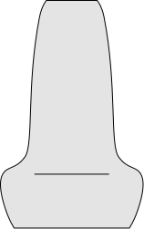
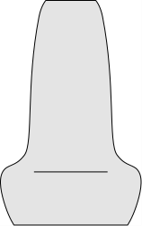
FAST Ultrasound
Holden et al. CARS 2015.
Completion time (s)
Probe path length (mm)
Points missed (%)

Slide 9
Ultrasound-Guided Central Line
McGraw et al. CJEM 2016.
1
1
2
2
Completion time (s)
Hand path length (mm)
Hand translational actions
Hand rotational actions

Slide 10
Lumbar Puncture
Yeo et al. AEM 2015.
Completion time (s)
Hand path length (mm)
Needle path length (mm)
Needle time in tissue (mm)
Needle path in tissue (mm)
Tissue damage (mm²)

Slide 11
Metric Validity
p<0.05?

Slide 12
Metric Validity
Difference in metric values for groups

Slide 13
Metric Validity
Difference in split groups

Slide 14
Exploratory Factor Analysis (EFA)
Time
Left Hand Motions
Right Hand Motions
Ultrasound Path Length
Needle
Path Length
Ultrasound Efficiency
Factor 1
Needle Efficiency
Factor 2
$$Time=a_{1}\left({Factor}_{1}\right)+a_{2}\left({Factor}_{2}\right)+a$$
$$LHM=b_{1}\left({Factor}_{1}\right)+b_{2}\left({Factor}_{2}\right)+b$$
$$…$$

Slide 15
Metric Validity
Dataset | Metric | p-value
FAST | Completion time (s) | <0.001
 | Points missed (%) | <0.001
 | Probe path length (mm) | <0.001
Central Line | Completion time (s) | 0.002
 | Probe hand path length (mm) | 0.024
 | Needle hand path length (mm) | 0.024
 | Probe hand rotational actions | 0.056
 | Needle hand rotational actions | 0.607
 | Probe hand translational actions | 0.006
 | Needle hand translational actions | 0.002
Lumbar Puncture | Completion time (s) | <0.001
 | Left hand path length (mm) | 0.001
 | Right hand path length (mm) | 0.007
 | Needle tip path length (mm) | 0.006
 | Tissue damage (mm²) | 0.010
 | Needle path in tissue (mm) | 0.026
 | Needle time in tissue (s) | 0.022

Slide 16
Metric Validity
Dataset | Metric | Mann-Whitney | Fisher’s Exact
FAST | Completion time (s) | <0.001 | <0.001
 | Points missed (%) | <0.001 | <0.001
 | Probe path length (mm) | <0.001 | <0.001
Central Line | Completion time (s) | 0.002 | <0.001
 | Probe hand path length (mm) | 0.024 | 0.015
 | Needle hand path length (mm) | 0.024 | 0.011
 | Probe hand rotational actions | 0.056 | 0.070
 | Needle hand rotational actions | 0.607 | 0.221
 | Probe hand translational actions | 0.006 | 0.005
 | Needle hand translational actions | 0.002 | <0.001
Lumbar Puncture | Completion time (s) | <0.001 | <0.001
 | Left hand path length (mm) | 0.001 | <0.001
 | Right hand path length (mm) | 0.007 | 0.003
 | Needle tip path length (mm) | 0.006 | 0.001
 | Tissue damage (mm²) | 0.010 | 0.001
 | Needle path in tissue (mm) | 0.026 | 0.026
 | Needle time in tissue (s) | 0.022 | 0.008

Slide 17
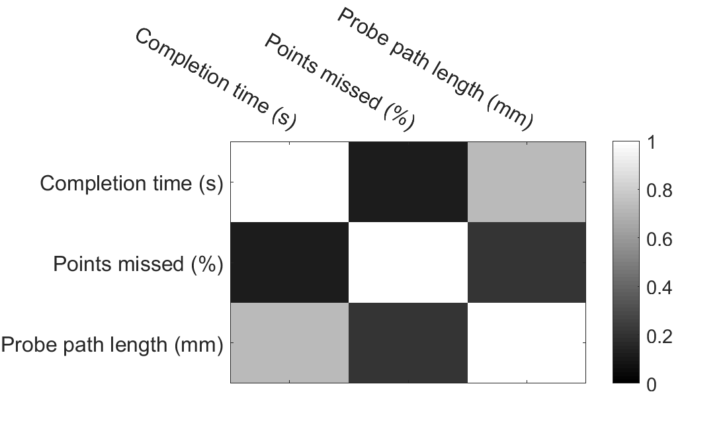
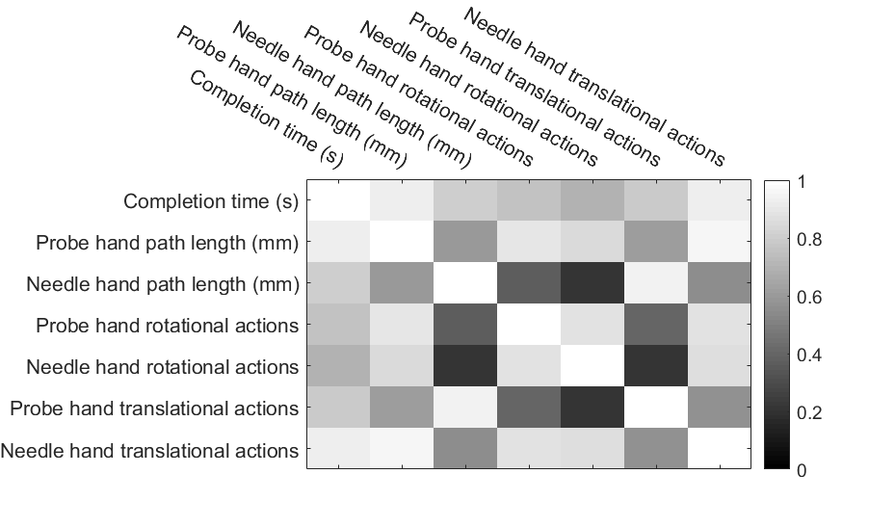
Metric Correlation

Slide 18
EFA: FAST Ultrasound

Slide 19
EFA: Ultrasound-Guided Central Line

Slide 20
EFA: Lumbar Puncture

Slide 21
Representative Metrics
Dataset | Metric | Interpretation
FAST | Completion time (s) | Efficiency
 | Points missed (%) | Thoroughness
Central Line | Needle hand path length (mm) | Needle hand efficiency
 | Probe hand translational actions | Probe hand efficiency
Lumbar Puncture | Right hand path length (mm) | Landmarking efficiency
 | Needle tip path length (mm) | Needle placement efficiency
 | Tissue damage (mm²) | Needle insertion efficiency

Slide 22
Overall Proficiency Classification
What we measure |  | Assessment
Time Instrument efficiency Hand motion Needle-tissue interaction Motion fluidity etc.
Sum of Z-Scores
or
SVM
Expert Novice

Slide 23
Overall Proficiency Classification: FAST Ultrasound

Slide 24
Overall Proficiency Classification: Ultrasound-Guided Central Line

Slide 25
Overall Proficiency Classification: Lumbar Puncture

Slide 26
Overall Proficiency Classification
Dataset | Sum of Z-Scores |  |  | Support Vector Machine
 | All AUC | Rep. AUC | p-value | All AUC | Rep. AUC | p-value
FAST | 0.84 | 0.83 | 0.45 | 0.84 | 0.84 | 0.44
Femoral Line | 1.00 | 1.00 | 0.50 | 1.00 | 1.00 | 0.50
Lumbar Puncture | 0.97 | 0.91 | 0.31 | 1.00 | 0.96 | 0.25

Slide 27
Interpretation

Slide 28
Conclusion
Time is insufficient for skill assessment
Application-specific metrics have added value
Skill in point-of-care ultrasound interventions is multi-faceted

Slide 29
Thank you!
Contact: Matthew S. Holden (72mh@queensu.ca)
http://perk.cs.queensu.ca/
This work was funded, in part, by NIH/NIBIB and NIH/NIGMS via grant 1R01EB021396-01A1 - Slicer+PLUS: Point-of-Care Ultrasound and by CANARIE’s Research Software Program. Matthew S. Holden is supported by the NSERC Canada Graduate Scholarship and the Link Foundation Fellowship in Modelling, Simulation, and Training. Gabor Fichtinger is supported as a Cancer Care Ontario Research Chair in Cancer Imaging.

