Slide 1
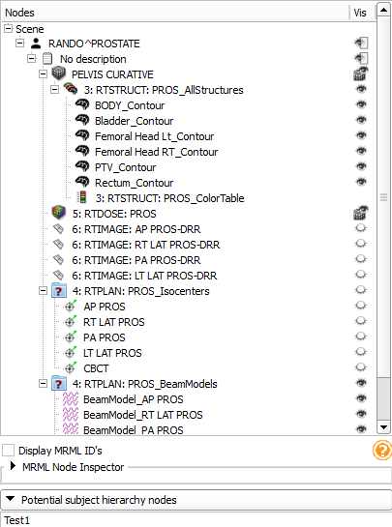
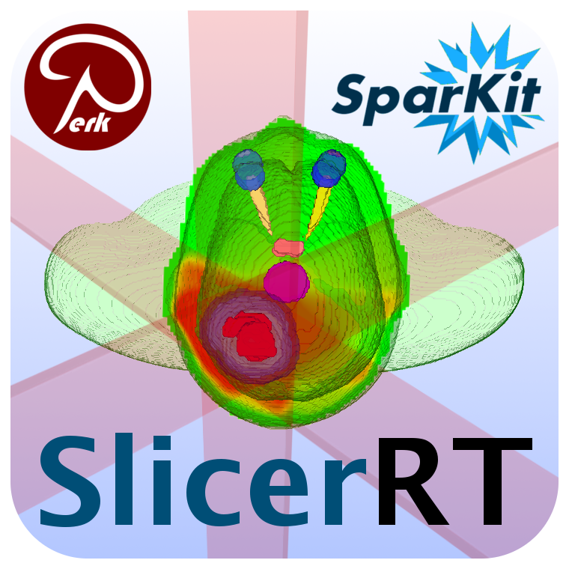
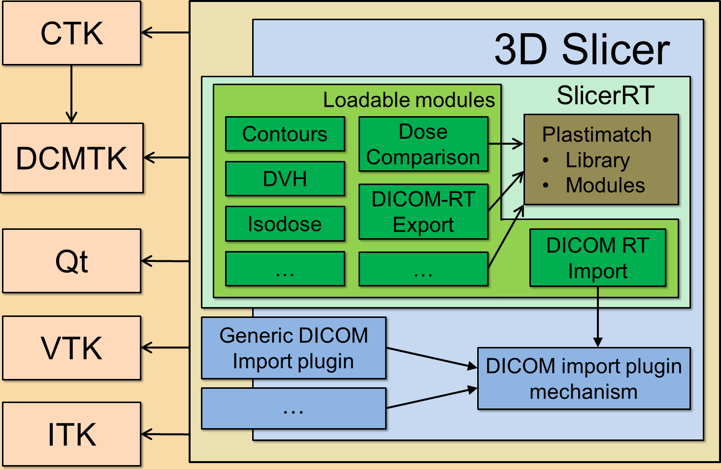
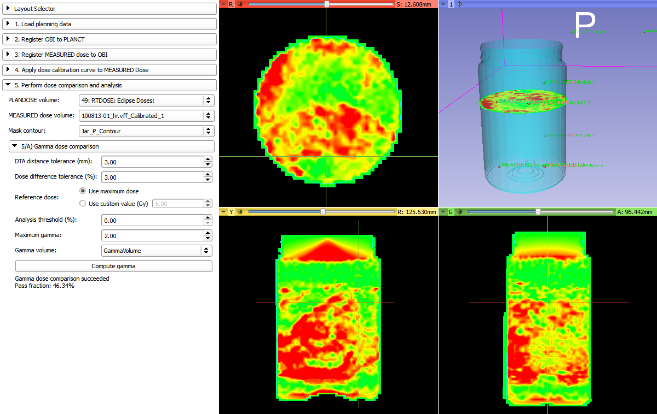
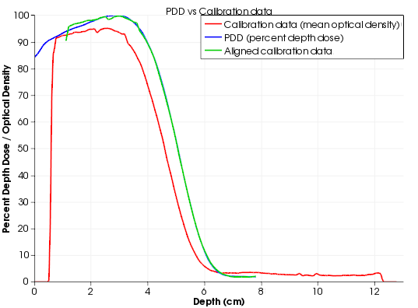
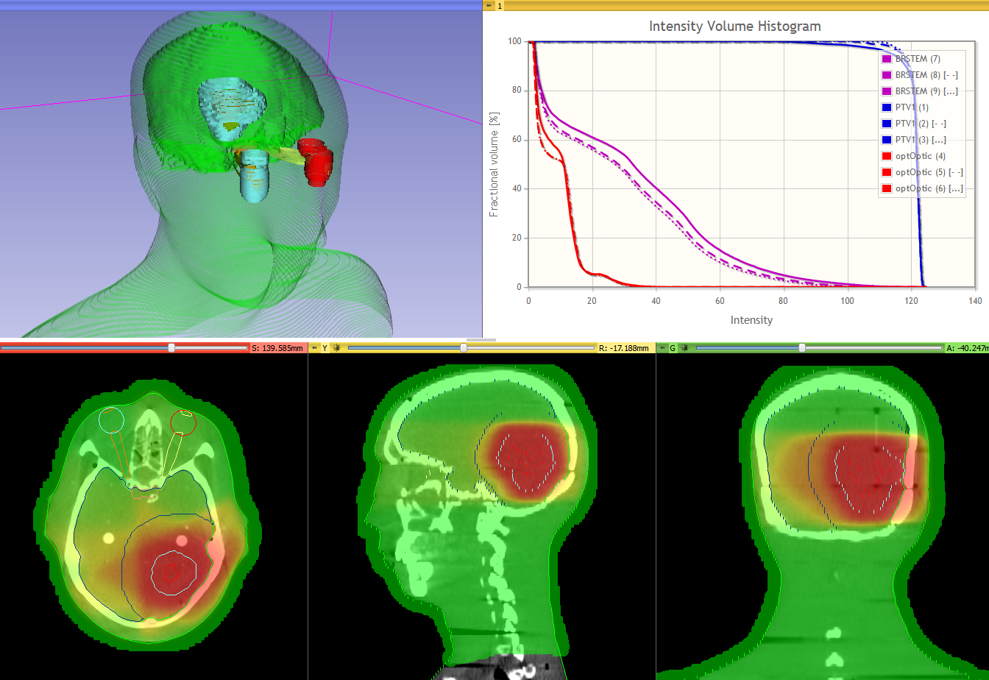



Improvements in SlicerRT, the radiation therapy research toolkit based on 3D Slicer
Csaba Pinter¹, Andras Lasso¹, An Wang², Gregory C. Sharp³, David Jaffray², Gabor Fichtinger¹
¹Laboratory for Percutaneous Surgery, School of Computing, Queen’s University, Kingston, ON
²Radiation Medicine Program, Princess Margaret Hospital, University Health Network, Toronto, ON
³Department of Radiation Oncology, Massachusetts General Hospital, Boston, MA, USA
Introduction
Results
Background
Radiation therapy (RT) software tools are mostly either expensive and closed proprietary applications or free open-source packages with limited scope, extensibility, reliability, or user support. This limits the potentials of collaborative RT research.
Objective
SlicerRT aspires to be an open-source toolkit for RT research, providing user-friendly interface, proven algorithms, and flexibility for researchers, and a general image-guided therapy infrastructure to assist clinical translation of experimental therapeutic approaches.
Improvements in the toolkit since ImNO 2013
Subject hierarchy
Nice and intuitive way of organizing and handling data. Brings basic features in a data-centered tree view, such as
Show/hide branch (for each type)
Transform branch
Create new nodes of any type
Extendable through plugins. Broad API allowing many customizations, such as
DICOM export
Registration from the tree
Parse local data storage
Support for RT-specific features
Creation of contour objects
etc.
Methods
Platform
SlicerRT is a downloadable extension to 3D Slicer (www.slicer.org)
Widely used as a software application platform in medical image computing
Already contains key functionalities
Reading DICOM images
Visualizing and manipulating datasets
Advanced segmentation, registration, etc.
Free, open-source
Extensible by custom modules
Large user and developer base
Subject hierarchy tree
Contour conversions
Rasterization (voxelization) of surface models to indexed labelmaps
Direct creation of closed surface model from planar ROI contours
External beam planning
Module for basic photon and proton beam planning
Import of RT plans with MLC beams, import of RT images
Gel dosimetry evaluation
“Slicelet” for step-by-step execution of a full gel dosimetry workflow
SlicerRT Extension logo in 3D Slicer
Design
Architectural overview of SlicerRT
Comparison of plan and calibration
Curve alignment for calibration
Conclusions
SlicerRT became a complete toolkit for RT researchers by providing most frequently used features for objective comparison and analysis of RT data and allowing researchers to easily develop and share their additional custom methods. Current funding ensures continuous development for several years and we expect that other research groups will also join these efforts.
Please visit http://www.SlicerRT.org and share with us your comments, ideas, and needs.
Overview paper: Csaba Pinter, Andras Lasso, An Wang, David Jaffray, and Gabor Fichtinger, “SlicerRT: Radiation therapy research toolkit for 3D Slicer”, Med. Phys. 39 (10), October 2012
Features
DICOM-RT import/export: structure set, dose distribution, RT image, plan
Contour analysis
Multiple representations (automatic conversion between them)
Contour Comparison: Dice coefficient, Hausdorff distance
Contour morphology
Expand, shrink
Logical operators
Dose analysis
Dose volume histogram (DVH)
Dose accumulation
Dose comparison (gamma)
Isodose contours / surfaces
External beam planning
Photon, proton
Data management
Subject hierarchy
Acknowledgements
SlicerRT has been made possible by funding from the Province of Ontario, Ontario Research Fund Research Excellence Program, Ontario Consortium for Adaptive Interventions in Radiation Oncology (OCAIRO), and An Applied Cancer Research Unit of Cancer Care Ontario with funds provided by the Ministry of Health and Long-Term Care. G.F. was funded as a Cancer Care Ontario Research Chair.
DVH curves for different adaptations

